Slide 1

Market Making

Slide 2
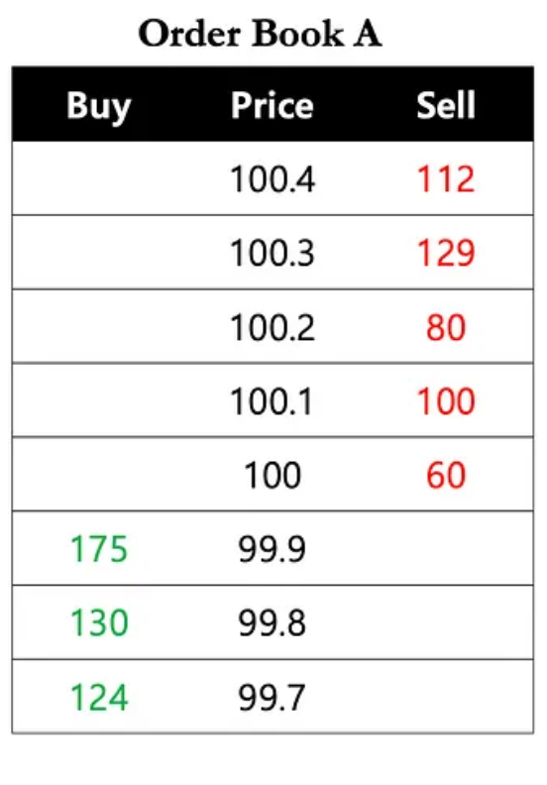
Order Book
Bid
Ask
A dynamic to record Bid and Ask offers.

Slide 3
Order Book
Bid
Ask
Transaction Rules:
1. When 最高的 Bid >= 最低的 Ask
2. 最惠價格配對 (largest gap)
3. 較新的 offer = 新的 Price
Example A:
藍 buy 1 unit at 100.3
綠 sell 1 unit at 100.3
Price -> 100.3

Slide 4
Order Book
Bid
Ask
Transaction Rules:
1. When 最高的 Bid >= 最低的 Ask
2. 最惠價格配對 (largest gap)
3. 較新的 offer = 新的 Price
Example B:
綠 sell 1 unit at 99.8
藍 buy 1 unit at 99.8
Price -> 99.8

Slide 5
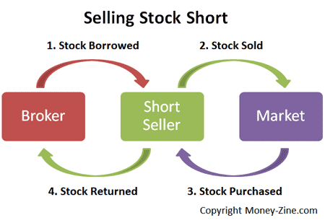
Position 倉位
買一 張/口: Position + 1
賣一 張/口: Position – 1
允許賣空: Position < 0
強制平倉: 自動賣/買給系統
Price * Position

Slide 6
Market Maker
Bid
Ask
MM: Try to offer the Highest Bid and Lowest Ask

Slide 7
Market Maker
Bid
Ask
Transaction Rules:
1. When Highest Bid >= Lowest Ask
2. Pair up with best deal(largest gap)
3. The later offer = New Price
Example C:
Blue buy 1 unit at 100.2
Red sold 1 unit at 100.2
Price become 100.2
Green sold 1 unit at 100
Red buy 1 unit at 100
Price become 100
Red earn 0.2

Slide 8
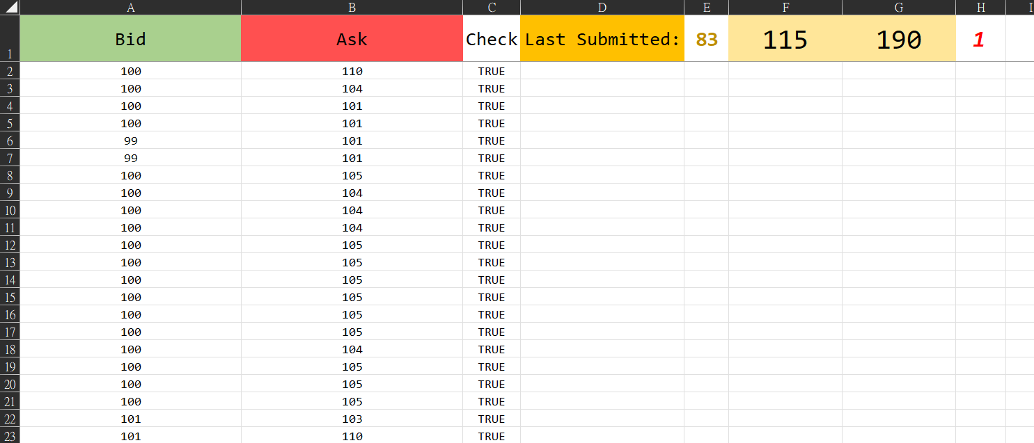
Our system – User 1 page

Slide 9
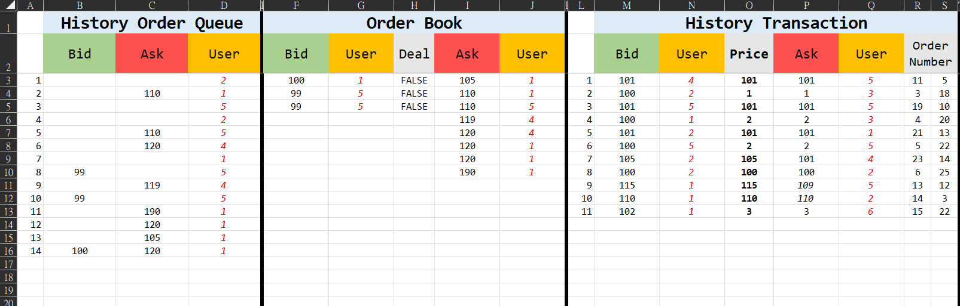
Our system – Home page

Slide 10

Game Rules

Slide 11

Banned Behavior
1. 只能輸入整數 [0,100000]
2. 禁止拖曳複製
3. 禁止輸入公式
黃牌警告
紅牌出場

Slide 12
Profit and Loss (P/L) Calculation Overview
Current P/L = 錢包有多少錢
Position = 持有多少部位(股/台)
End Price = 每輪結算價格
Net P/L = Current P/L + Position * End Price = 每輪得分

Slide 13
Details about each round
Round End Price Information
1: Daily Closed Price None
2: Daily Closed Price None/ Initial Order Book
*Announce the hint for Maturity Spot Price
3: Maturity Spot Price Hint

Slide 14
Profit and Loss (P/L) Calculation
Current P/L =
(Sell_1 + Sell_2 + …) – (Buy_1 + Buy_2 + …)
Position =
Number of Buy – Number of Sell
End Price =
(1st and 2nd round): Daily Closed Price – no one know
(3rd round): Maturity Spot Price – we won’t tell you
Net P/L = Current P/L + Position * End Price

Slide 15
2 ways to make profit
MM
Speculation

Slide 16
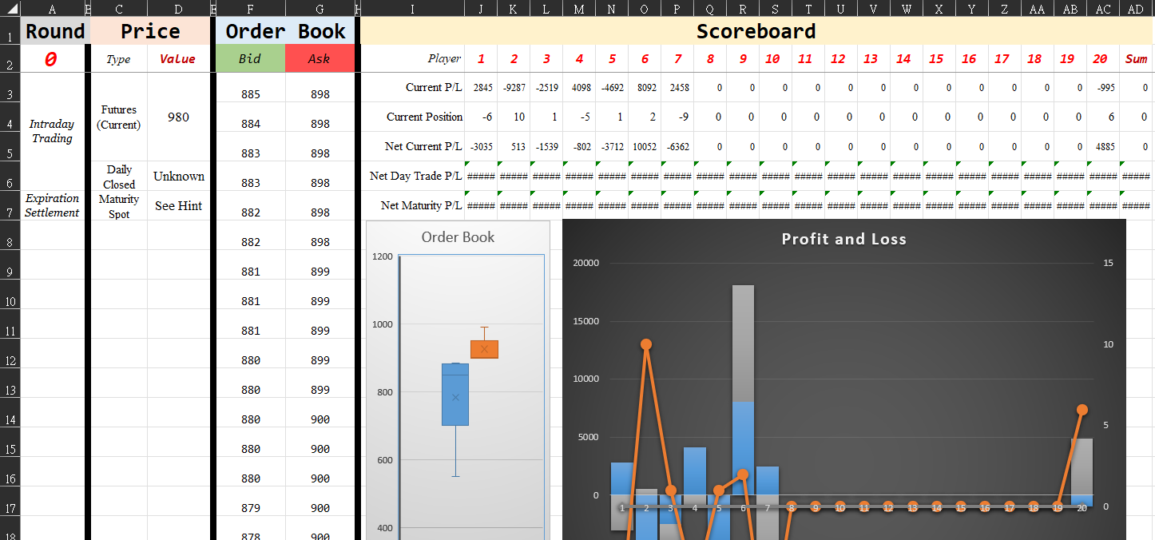
Our system – Scoreboard page

Slide 17
Profit and Loss Bound of each round
Round End Price Information
1: Daily Closed Price None
2: Daily Closed Price None/ Initial Order Book
*Announce the hint for Maturity Spot Price
3: Maturity Spot Price Hint

Slide 18
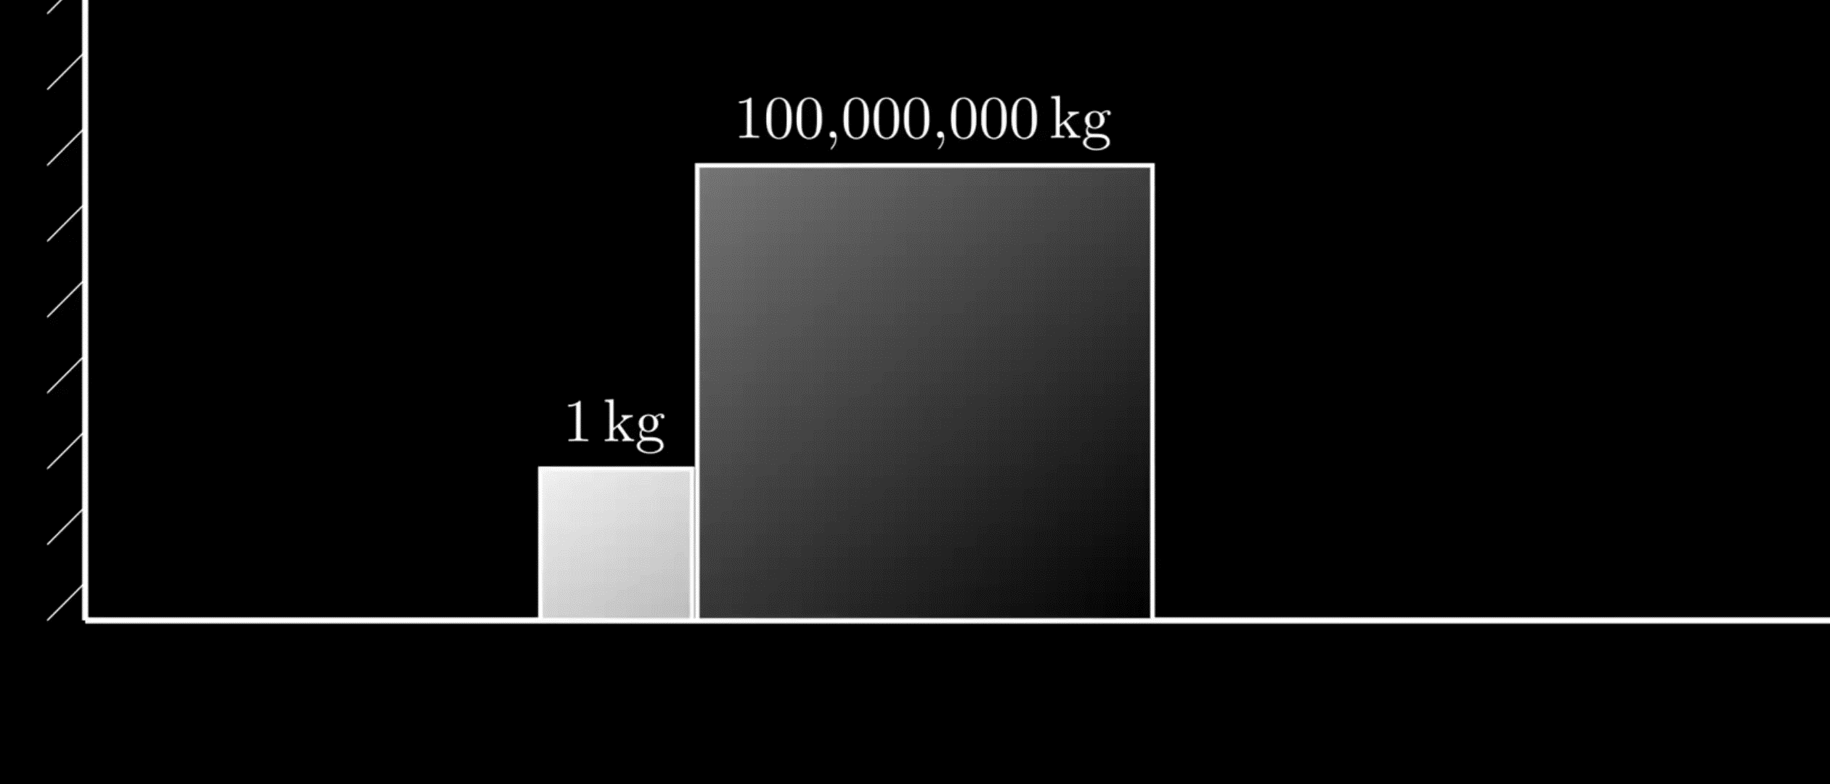
3rd round end price hint
Maturity Spot Price = 2nd round end price + N (number of collisions)

Slide 19
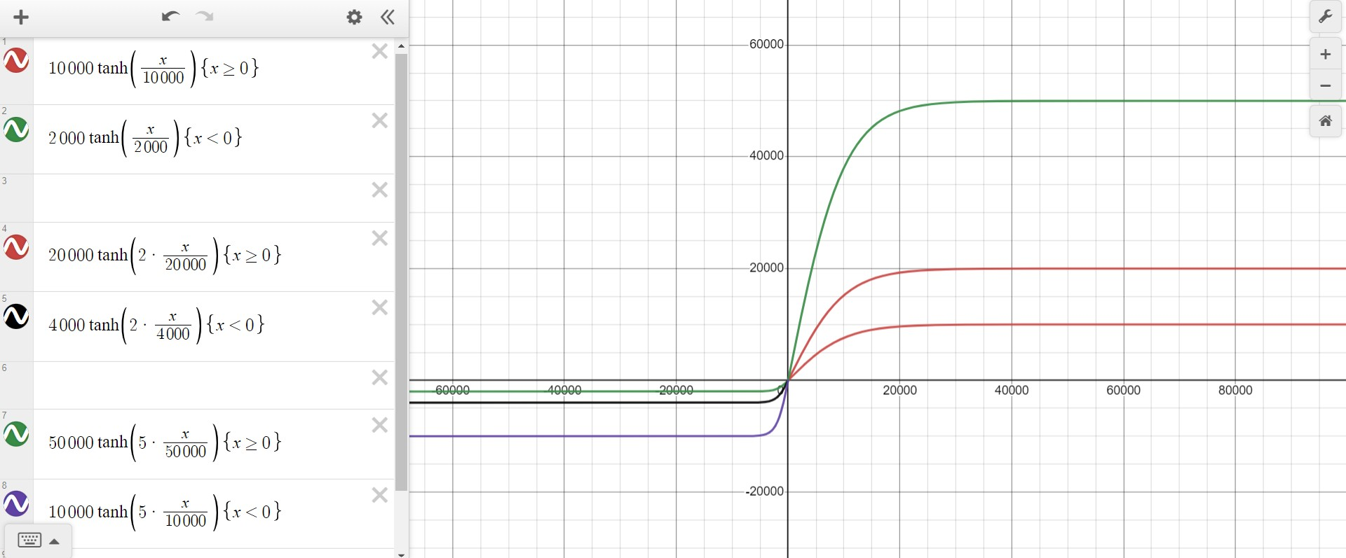
貨幣換算
*領支票換籌碼

